Slide 1
Memory
Memory Organization, hierarchy, RAM, ROM, Memory Address map, Cache, Memory Management

Slide 2
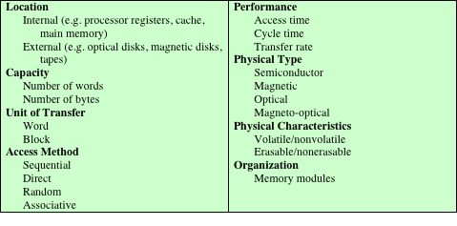
Key Characteristics of Computer Memory Systems
Table 4.1 Key Characteristics of Computer Memory Systems

Slide 3
Characteristics of Memory Systems
Location
Refers to whether memory is internal and external to the computer
Internal memory is often equated with main memory
Processor requires its own local memory, in the form of registers
Cache is another form of internal memory
External memory consists of peripheral storage devices that are accessible to the processor via I/O controllers
Capacity
Memory is typically expressed in terms of bytes (1 byte=8 bits or words)
Common word lengths are 8, 16, and 32 bits.
Unit of transfer
For internal memory the unit of transfer is equal to the number of electrical lines into and out of the memory module
This may be equal to the word length, but is often larger, such as 64, 128, or 256 bits.

Slide 4
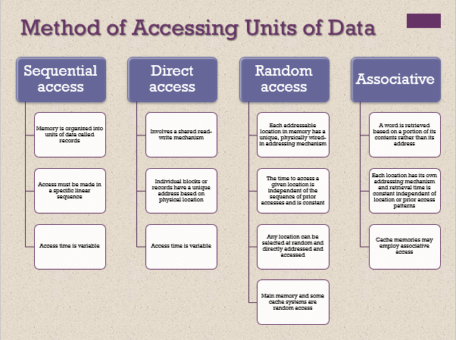

Slide 5
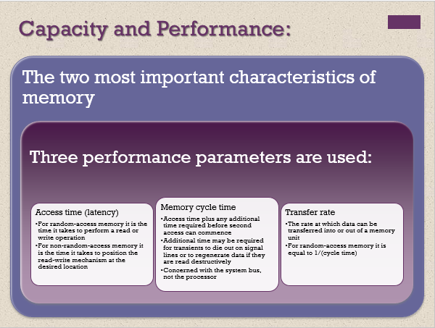

Slide 6
Memory
The most common forms are:
Semiconductor memory
Magnetic surface memory
Optical
Magneto-optical
Several physical characteristics of data storage are important:
Volatile memory
Information decays naturally or is lost when electrical power is switched off
Nonvolatile memory
Once recorded, information remains without deterioration until deliberately changed
No electrical power is needed to retain information
Magnetic-surface memories
Are nonvolatile
Semiconductor memory
May be either volatile or nonvolatile
Nonerasable memory
Cannot be altered, except by destroying the storage unit
Semiconductor memory of this type is known as read-only memory (ROM)
For random-access memory the organization is a key design issue
Organization refers to the physical arrangement of bits to form words

Slide 7
Memory Hierarchy
Design constraints on a computer’s memory can be summed up by three questions:
How much, how fast, how expensive
There is a trade-off among capacity, access time, and cost
Faster access time, greater cost per bit
Greater capacity, smaller cost per bit
Greater capacity, slower access time
The way out of the memory dilemma is not to rely on a single memory component or technology, but to employ a memory hierarchy

Slide 8
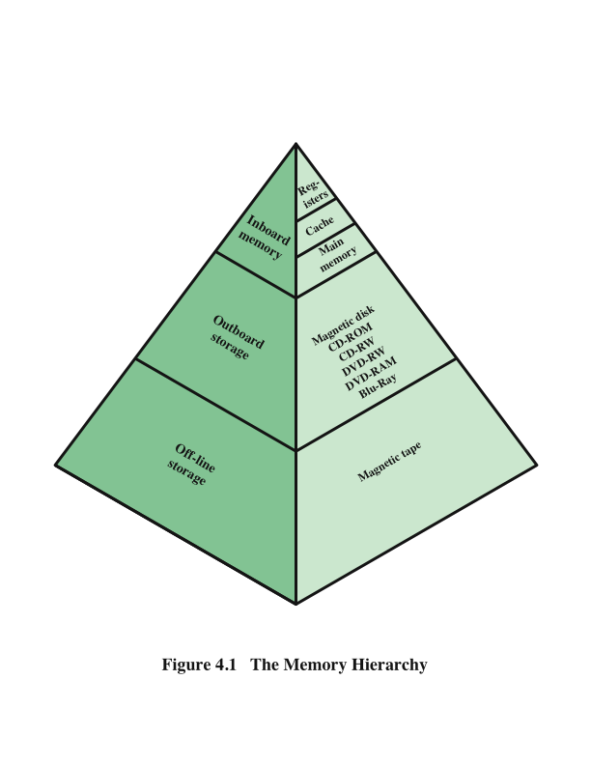
Memory Hierarchy - Diagram
As one goes down the hierarchy, the following occur:
a. Decreasing cost per bit
b. Increasing capacity
c. Increasing access time
d. Decreasing frequency of access of the memory by the processor

Slide 9
Internal Memory
ROM, DRAM, and SRAM

Slide 10
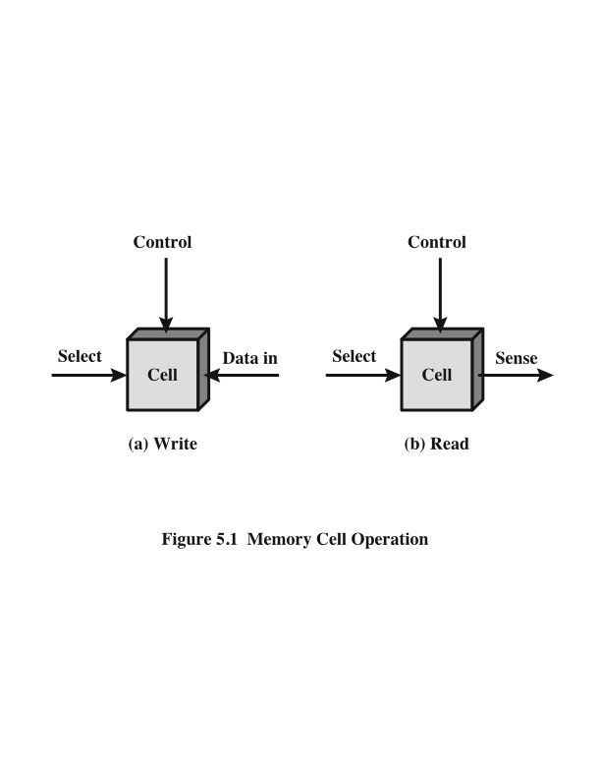
Memory Cell Operation

Slide 11
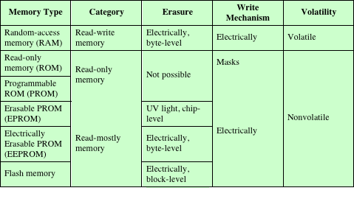
Semiconductor Memory Types
Table 5.1 Semiconductor Memory Types

Slide 12
Dynamic RAM (DRAM)
RAM technology is divided into two technologies:
Dynamic RAM (DRAM)
Static RAM (SRAM)
DRAM
Made with cells that store data as charge on capacitors
Presence or absence of charge in a capacitor is interpreted as a binary 1 or 0
Requires periodic charge refreshing to maintain data storage
The term dynamic refers to tendency of the stored charge to leak away, even with power continuously applied

Slide 13
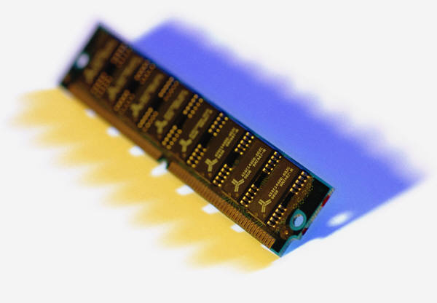
Static RAM (SRAM)
Digital device that uses the same logic elements used in the processor
Binary values are stored using traditional flip-flop logic gate configurations
Will hold its data as long as power is supplied to it

Slide 14
SRAM versus DRAM
SRAM
Both volatile
Power must be continuously supplied to the memory to preserve the bit values
Dynamic cell
Simpler to build, smaller
More dense (smaller cells = more cells per unit area)
Less expensive
Requires the supporting refresh circuitry
Tend to be favored for large memory requirements
Used for main memory
Static
Faster
Used for cache memory (both on and off chip)
DRAM

Slide 15
Read Only Memory (ROM)
Contains a permanent pattern of data that cannot be changed or added to
No power source is required to maintain the bit values in memory
Data or program is permanently in main memory and never needs to be loaded from a secondary storage device
Data is actually wired into the chip as part of the fabrication process
Disadvantages of this:
No room for error, if one bit is wrong the whole batch of ROMs must be thrown out
Data insertion step includes a relatively large fixed cost

Slide 16
Programmable ROM (PROM)
Less expensive alternative
Nonvolatile and may be written into only once
Writing process is performed electrically and may be performed by supplier or customer at a time later than the original chip fabrication
Special equipment is required for the writing process
Provides flexibility and convenience
Attractive for high volume production runs

Slide 17
Read-Mostly Memory
EPROM
Erasable programmable read-only memory
Erasure process can be performed repeatedly
More expensive than PROM but it has the advantage of the multiple update capability
EEPROM
Electrically erasable programmable read-only memory
Can be written into at any time without erasing prior contents
Combines the advantage of non-volatility with the flexibility of being updatable in place
More expensive than EPROM
Flash Memory
Intermediate between EPROM and EEPROM in both cost and functionality
Uses an electrical erasing technology, does not provide byte-level erasure
Microchip is organized so that a section of memory cells are erased in a single action or “flash”

Slide 18
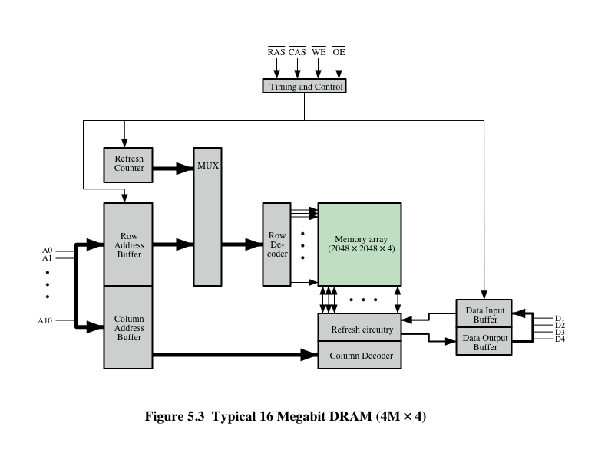
Typical 16 Mb DRAM (4M x 4)
RAS= Row Address Select
CAS= Column Address Select
WE= Write Enable
OE= Output Enable

Slide 19
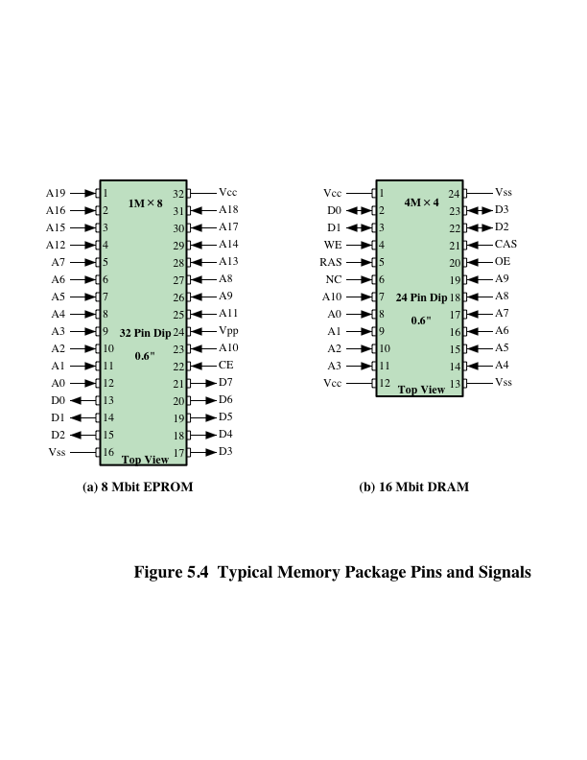
Chip Packaging
The power supply to the chip (V_{cc}).
A ground pin (V_{ss}).
A program voltage (V_{pp}) that is supplied during programming (write operations).

Slide 20
Error Correction
Hard Failure
Permanent physical defect
Memory cell or cells affected cannot reliably store data but become stuck at 0 or 1 or switch erratically between 0 and 1
Can be caused by:
Harsh environmental abuse
Manufacturing defects
Soft Error
Random, non-destructive event that alters the contents of one or more memory cells
No permanent damage to memory
Can be caused by:
Power supply problems
Alpha particles due to radioactivity falloff which is common in all materials

Slide 21
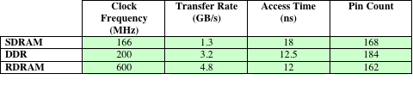
Advanced DRAM Organization
Synchronous SDRAM
One of the most critical system bottlenecks when using high-performance processors is the interface to main internal memory
The traditional DRAM chip is constrained both by its internal architecture and by its interface to the processor’s memory bus
A number of enhancements to the basic DRAM architecture have been explored:
Double Data Rate
DDR-DRAM
RamBus
RDRAM
Table 5.3 Performance Comparison of Some DRAM Alternatives

Slide 22
Synchronous DRAM (SDRAM)
One of the most widely used forms of DRAM
Exchanges data with the processor synchronized to an external clock signal and running at the full speed of the processor/memory bus without imposing wait states
With synchronous access the DRAM moves data in and out under control of the system clock
The processor or other master issues the instruction and address information which is latched by the DRAM
The DRAM then responds after a set number of clock cycles
Meanwhile the master can safely do other tasks while the SDRAM is processing

Slide 23
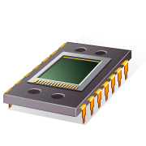
RDRAM
Developed by Rambus
Adopted by Intel for its Pentium and Itanium processors
Has become the main competitor to SDRAM
Chips are vertical packages with all pins on one side
Exchanges data with the processor over 28 wires no more than 12 centimeters long
Bus delivers address and control information using an asynchronous block-oriented protocol
Gets a memory request over the high-speed bus
Request contains the desired address, the type of operation, and the number of bytes in the operation

Slide 24
Double Data Rate SDRAM (DDR SDRAM)
SDRAM can only send data once per bus clock cycle
Double-data-rate SDRAM can send data twice per clock cycle, once on the rising edge of the clock pulse and once on the falling edge

Slide 25
Cache Memory
Cache memory is designed to combine the memory access time of expensive, high-speed memory combined with the large memory size of less expensive, lower-speed memory.

Slide 26
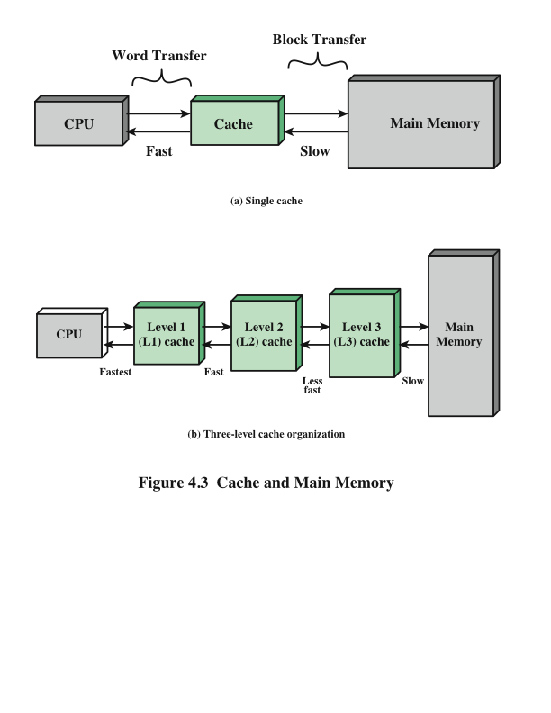
Cache and Main Memory

Slide 27
Cache and Main Memory
Suppose that the processor has access to two levels of memory. Level 1contains 1000 words and has an access time of 0.01 s; level 2 contains 100,000 words and has an access time of 0.1 µs. Assume that if a word to be accessed is in level 1, then the processor accesses it directly. If it is in level 2, then the word is first transferred to level 1 and then accessed by the processor. For simplicity, we ignore the time required for the processor to determine whether the word is in level 1 or level 2.
Suppose 95% of the memory accesses are found in the cache. Then the average time to access a word can be expressed as
(0.95)(0.01 µs) + (0.05)(0.01 µs + 0.1 µs) = 0.0095 + 0.0055 = 0.015 µs
The average access time is much closer to 0.01 µs than to 0.1 µs, as desired.

Slide 28
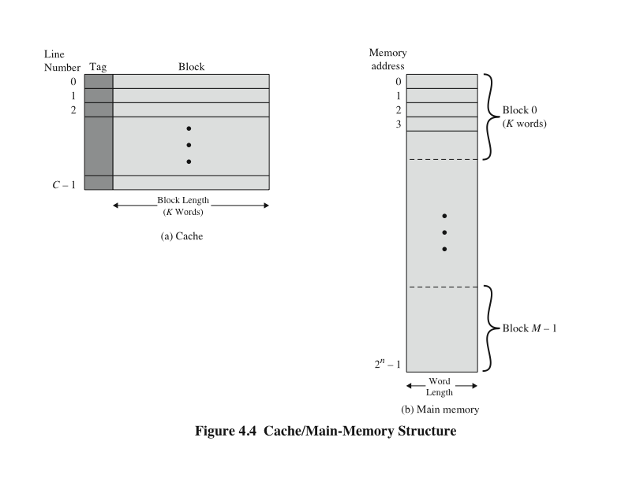
Cache/Main Memory Structure

Slide 29
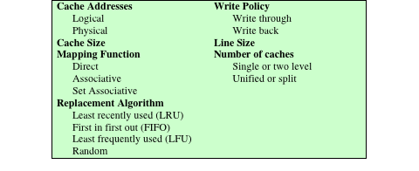
Elements of Cache Design
Table 4.2 Elements of Cache Design

Slide 30
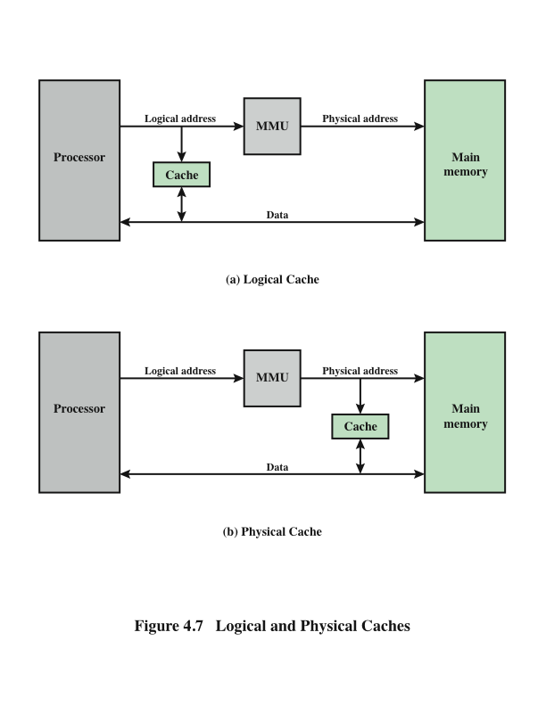
Logical and Physical Caches

Slide 31
Cache Addresses
Virtual Memory
Virtual memory
Facility that allows programs to address memory from a logical point of view, without regard to the amount of main memory physically available
When used, the address fields of machine instructions contain virtual addresses
For reads to and writes from main memory, a hardware memory management unit (MMU) translates each virtual address into a physical address in main memory

Slide 32
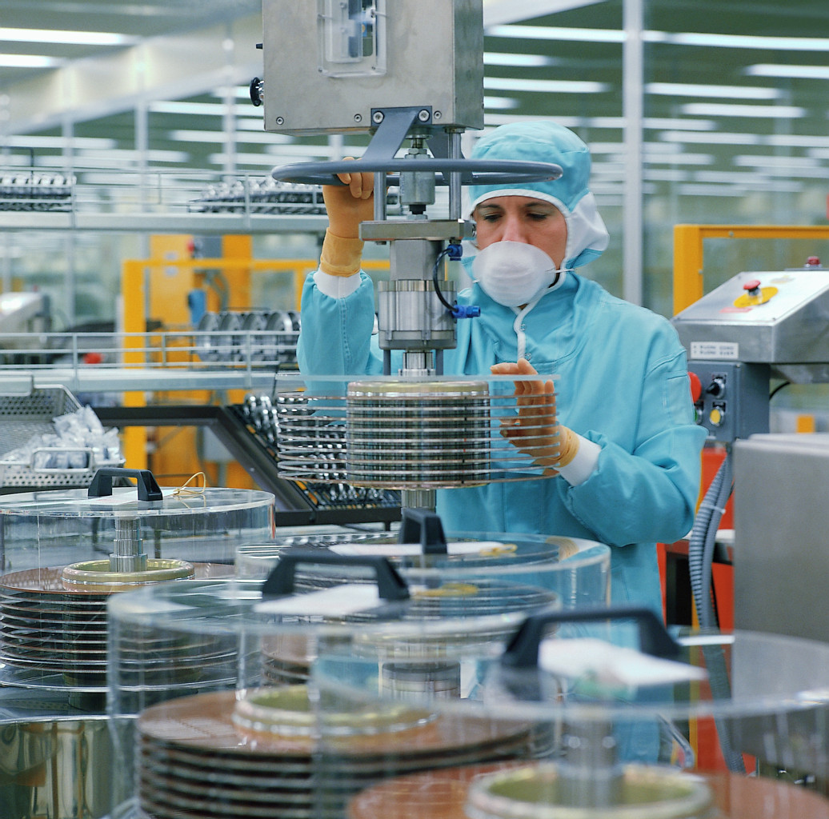
Magnetic Disk
A disk is a circular platter constructed of nonmagnetic material, called the substrate, coated with a magnetizable material
Traditionally the substrate has been an aluminium or aluminium alloy material
Recently glass substrates have been introduced
Benefits of the glass substrate:
Improvement in the uniformity of the magnetic film surface to increase disk reliability
A significant reduction in overall surface defects to help reduce read-write errors
Ability to support lower fly heights
Better stiffness to reduce disk dynamics
Greater ability to withstand shock and damage

Slide 33
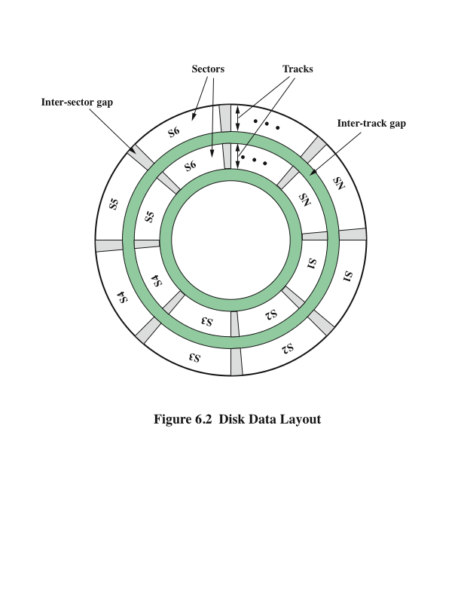
Disk Data Layout

Slide 34
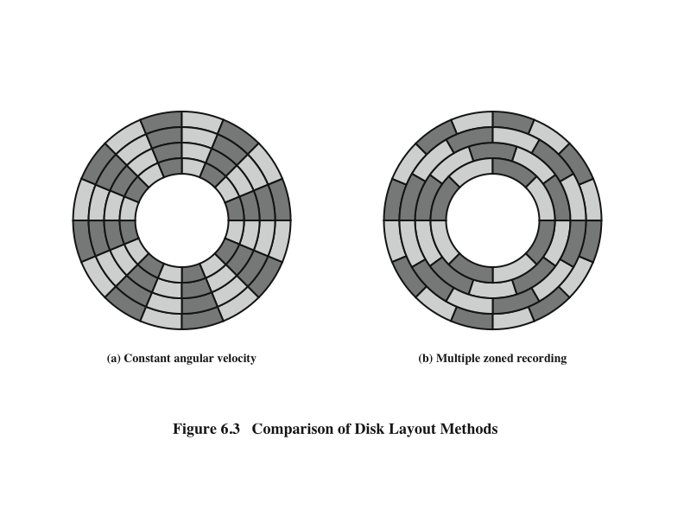
Disk Layout Methods Diagram

